Slide 1

What The CAF Module 04: ALZ Accelerator Azure Landing Zone Design Principles, Considerations, and Recommendations
Last updated: Sep 2022

Slide 2
Agenda
● Azure landing zones
● What is Enterprise-scale?
● Enterprise-scale Design Principles
● Enterprise-scale Design Guidelines
● Enterprise-scale Implementation Guide
● Enterprise-scale Reference Implementations
● Resources & Next Steps

Slide 3
Azure Landing Zones

Slide 4
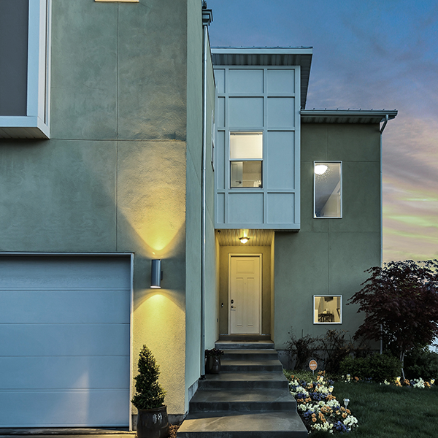
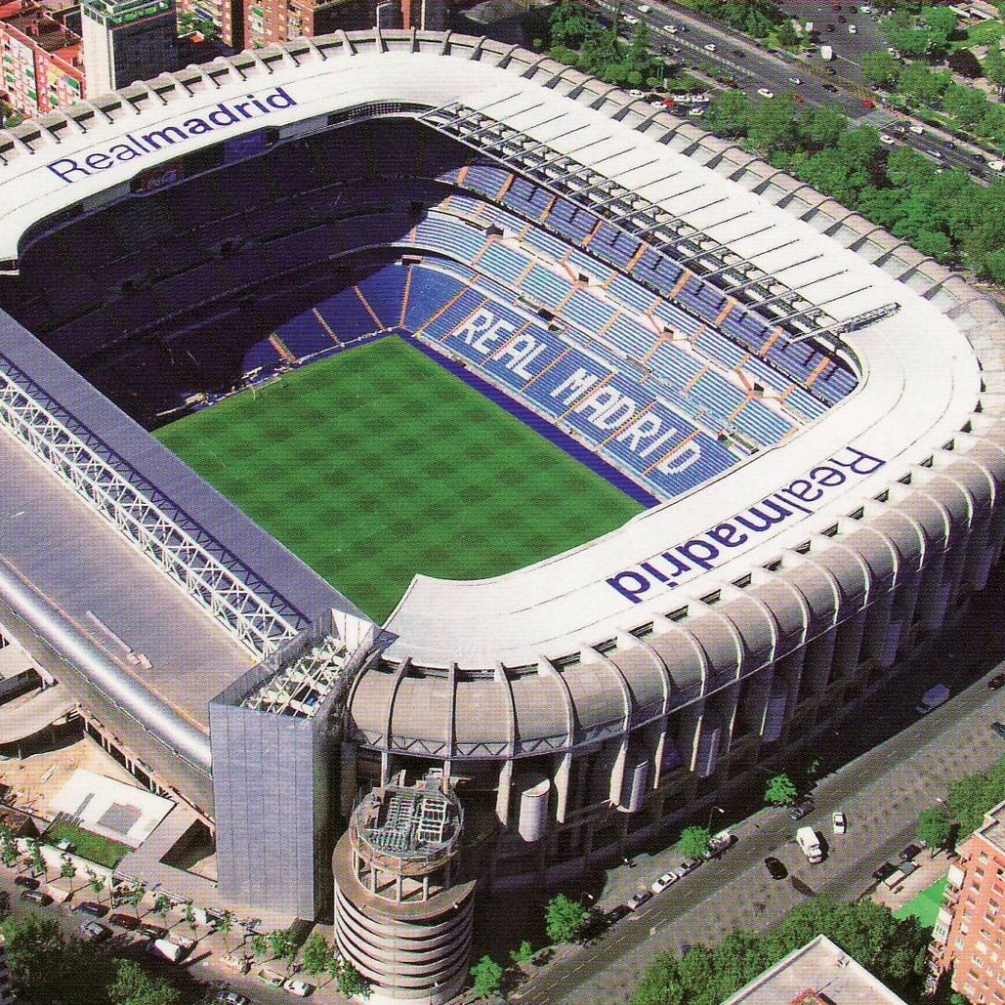

What are you building? Your cloud foundation supports the construction of a—
House
Stadium
Bridge

Slide 5
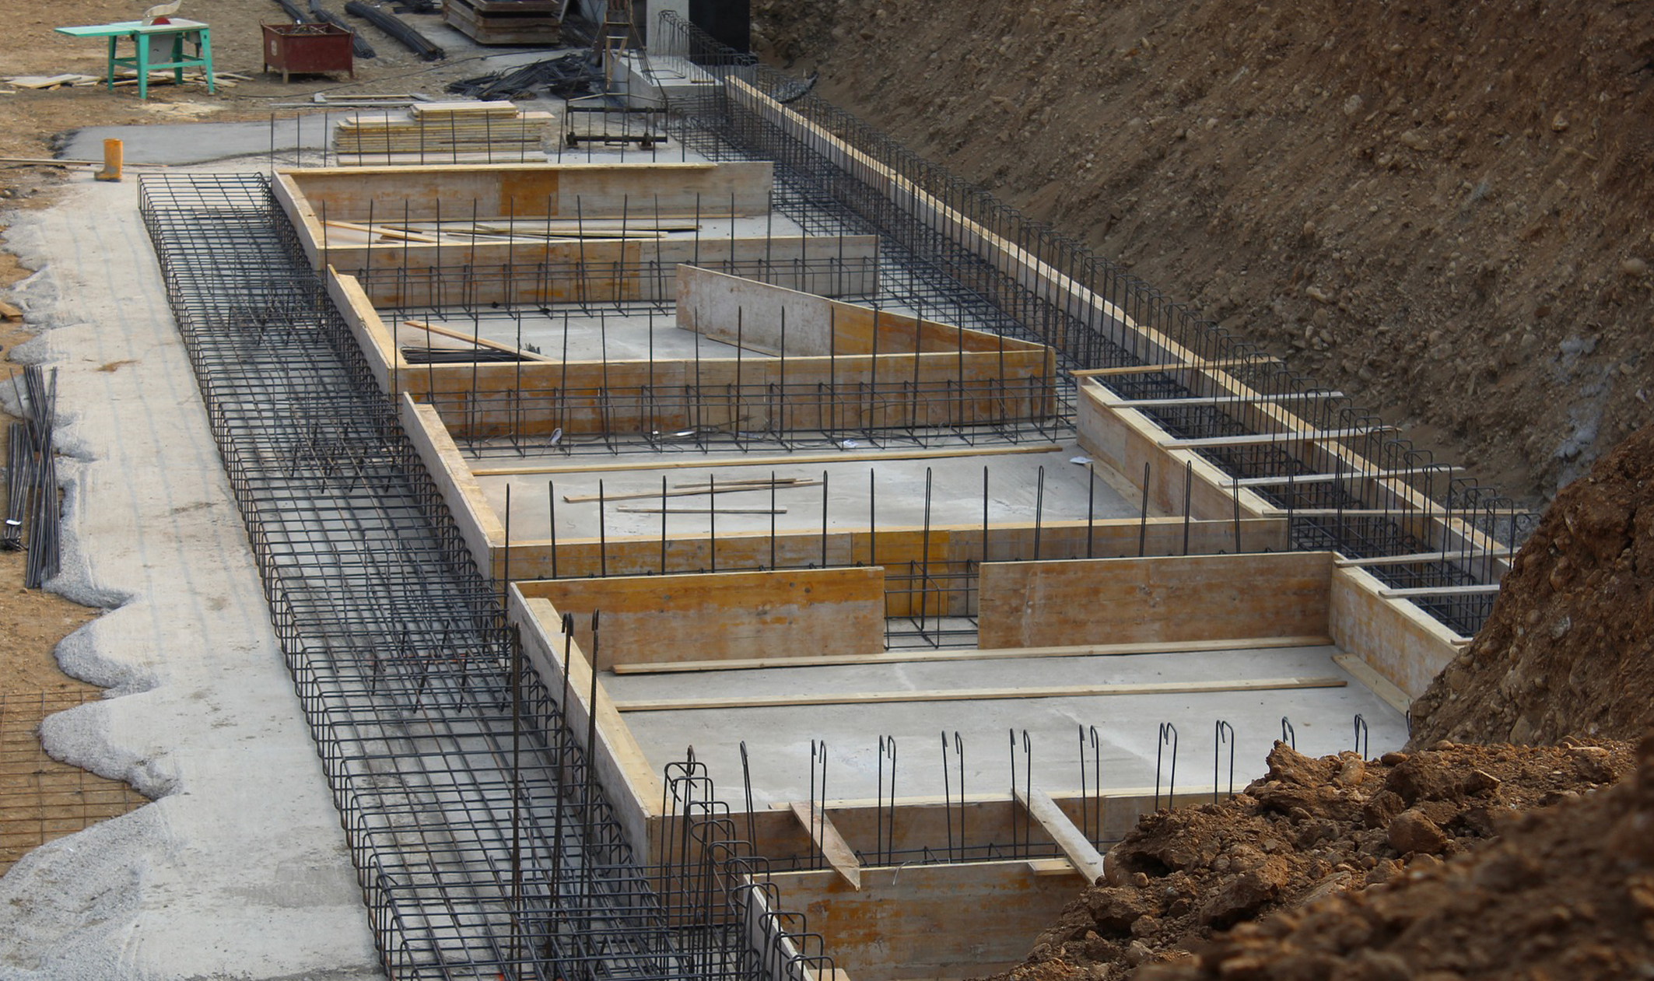
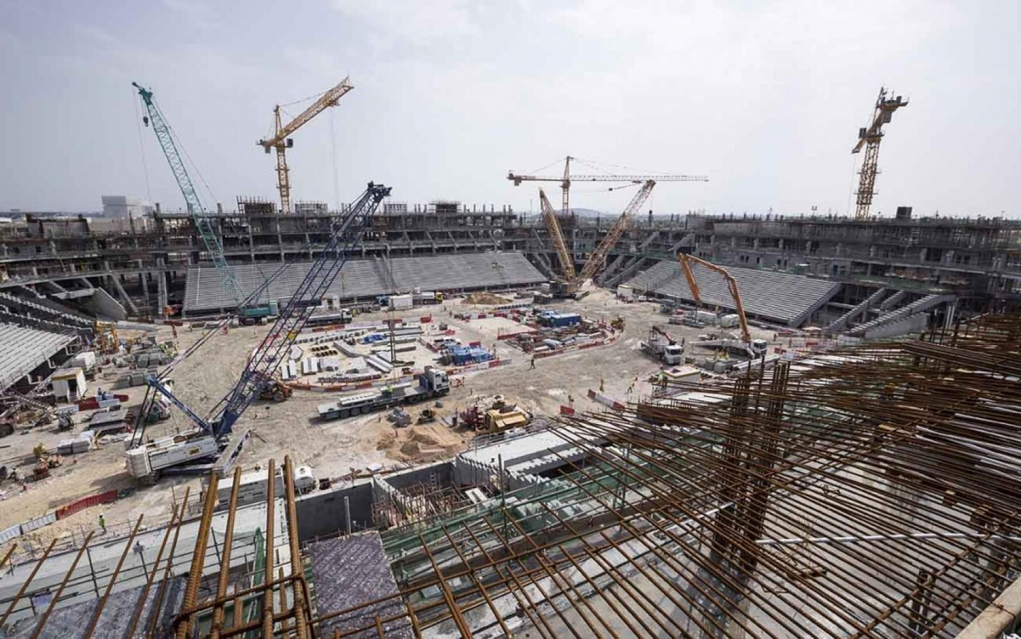
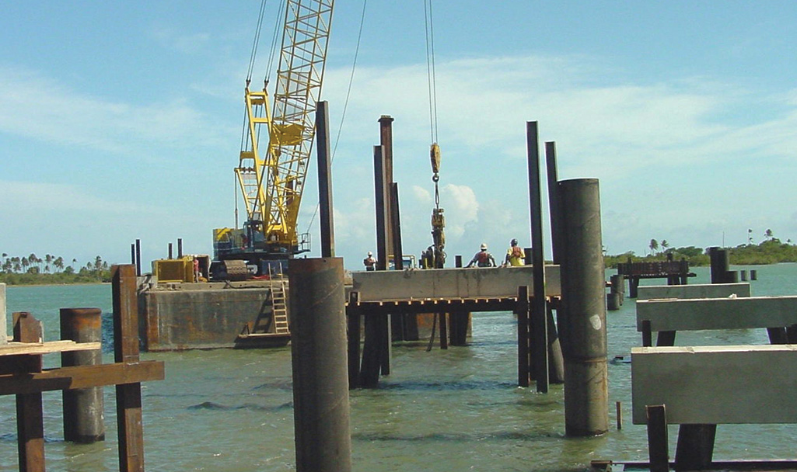
All foundations are NOT created equal
A house
A stadium
A bridge

Slide 6
What are landing zones for?
Starting a journey based on best practices with a start-to-finish plan is a key factor for success
Creating well-designed foundations for a cloud environment will enable the safe adoption of new technologies, at pace
Using consistent, repeatable environment designs helps scaling out in a manageable way
Baking in repeatable best practices into environment deployments
Factoring your team's technical skills into environment planning

Slide 7
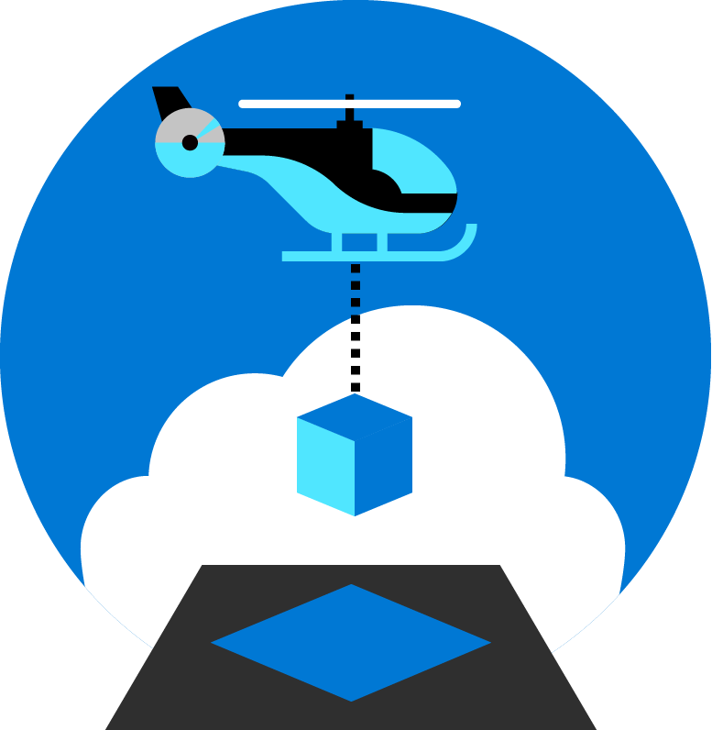
Azure landing zones
Set up Azure environments— for scale, security, governance, networking, and identity
Enable migrations and net new apps
Consider all platform resources
Don't differentiate between IaaS or PaaS

Slide 8

Azure landing zones Design areas
Azure billing & Azure Active Directory tenant
Security
Identity & access management
Governance
ENVIRONMENT
COMPLIANCE
Resource organization
Management
Network topology & connectivity
Platform automation & DevOps

Slide 9
Enterprise-scale demystified

Slide 10



The Key Challenges
Architecture Complexity: Most customers lack the required level of knowledge & experience on Azure. The mismatch between on-premises infrastructure and cloud-design considerations creates friction when trying to define architectures and standards for their migration to the cloud.
They are struggling with the translation of their requirements to Azure concepts, capabilities, constructs and security model.
Operating Compatibility: Existing approaches and functions for the traditional delivery and management of IT services are not compatible with Azure and cloud operating models.
When combined with a lack of skills and experience, customers are struggling to define (and therefore transform) their operating model to manage and support cloud infrastructure.
Lack of Trust and Desire for Control: The absence of a precise and detailed cloud architecture that is compliant with their requirements, and the lack of a well-defined operating model to support such a platform, leads IT not to trust Azure and instead strive to maintain full control.
This often involves building ‘walls’ and complicated processes which ultimately get in the way of business lines adopting Azure.

Slide 11
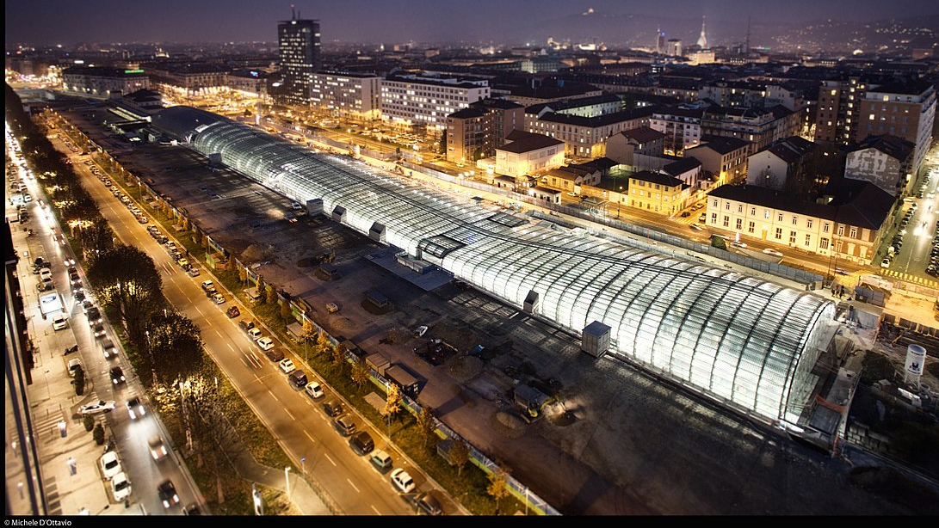
Metropolis
Using an analogy, this is similar to how city utilities such as water, gas, and electricity are accessible before new houses are constructed. In this context, the network, IAM, policies, management, and monitoring are shared 'utility' services that must be readily available to help streamline the application migration process.

Slide 12
Enterprise-scale?
Enterprise-scale is an architecture approach and reference implementation that enables effective construction and operationalization of landing zones on Azure, at scale and aligned with Azure Roadmap and Microsoft Cloud Adoption Framework for Azure.
Authoritative Provides a holistic design decision framework for Azure Platform.
Proven
Based on the success of large-scale migration projects at-scale, but not only.
Prescriptive Apply it on a clear plan and design your Azure environment.
The Architecture:
Design principles: Principles to help/guide you customize the design.
Design guidelines: Guidelines (decisions and recommendations) for the 8 components of the enterprise-scale architecture
Implementation guide: The way you create those things using the reference implementations in GitHub and deployment pipelines
The Reference Implementation:
Foundation: A reference implementation of shared services containing network, security, identity, governance services required to construct and operationalize an enterprise-scale landing zone
Landing zone(s): A reference implementation of a workload environment conforming to the enterprise-scale architecture (opinionated way to implement, code)

Slide 13
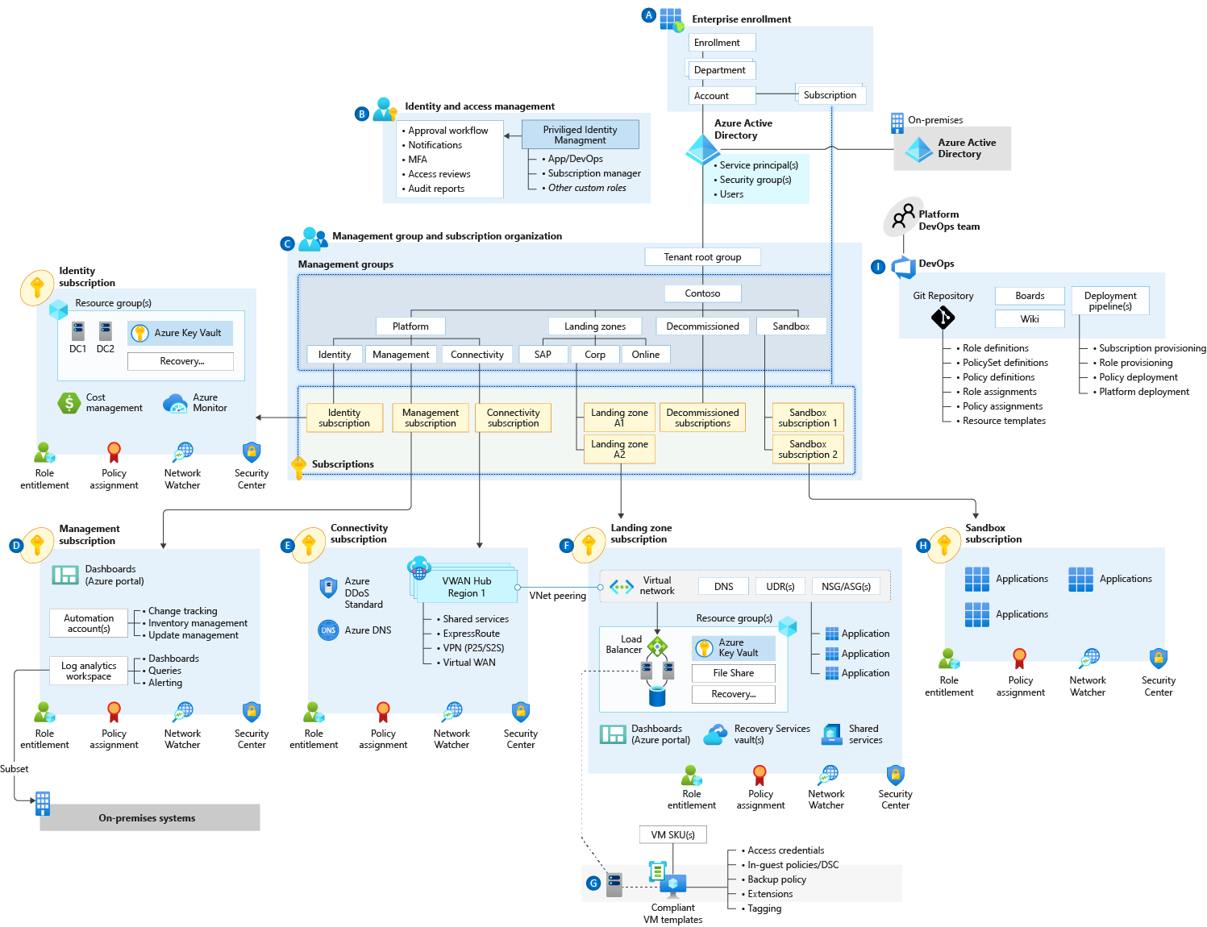
Enterprise-scale

Slide 14
Enterprise-scale landing zone(s) The principal purpose of the “Landing Zone” is therefore to ensure that when an application or workload lands on Azure, the required “plumbing” is already in place, providing greater agility and compliance with enterprise security and governance requirements.

Slide 15
But should I start with ESLZ? The enterprise-scale architecture is modular by design and allows you to start with a foundational landing zone control plane that supports your application portfolios, whether the applications are being migrated or are newly developed and deployed to Azure. The architecture can scale alongside your business requirements, regardless of scale point.

Slide 16
Design Principles

Slide 17
Enterprise-scale Design Principles
Subscription Democratisation
Policy Driven Governance
Single Control and Management Plane
Application Centric and Archetype-Neutral
Azure Native Design and Platform Roadmap Alignment
Enable Autonomy for Innovation and Transformation
Security and Compliance By-Default
Governance At-Scale with Sustainable Cloud Engineering

Slide 18
Enterprise-scale Design Principles
Subscription Democratization
Policy Driven Governance
Single Control and Management Plane
Application Centric and Archetype-Neutral
Azure Native Design and Platform Roadmap Alignment
Subscriptions should be used as a unit of management and scale aligned with business needs and priorities, to support business areas and portfolio owners to accelerate application migrations and new application development.

Slide 19
Enterprise-scale Design Principles
Azure Policy should be used to provide the guard-rails and ensure the continued compliance of the customer platform and applications deployed onto it, whilst also providing application owners sufficient freedom and a secure unhindered path to cloud.
Subscription Democratisation
Policy Driven Governance
Single Control and Management Plane
Application Centric and Archetype-Neutral
Azure Native Design and Platform Roadmap Alignment

Slide 20
Enterprise-scale Design Principles
The Enterprise-scale architecture should not consider any abstraction layers such as customer developed portals or tooling and should provide a consistent experience for both AppOps (centrally managed operation teams) and DevOps (dedicated application operation teams).
Subscription Democratisation
Policy Driven Governance
Single Control and Management Plane
Application Centric and Archetype-Neutral
Azure Native Design and Platform Roadmap Alignment

Slide 21
Enterprise-scale Design Principles
We should focus on application centric migrations and development rather than a pure infrastructure "lift and shift" migration (i.e. movement of virtual machines) and should not differentiate between old/new applications or IaaS/PaaS applications.
Subscription Democratisation
Policy Driven Governance
Single Control and Management Plane
Application Centric and Archetype-Neutral
Azure Native Design and Platform Roadmap Alignment

Slide 22
Enterprise-scale Design Principles
The Enterprise Scale architecture approach advocates the use of native platform services and capabilities whenever possible, which should be aligned with Azure platform roadmaps to ensure new capabilities are made available within customer environments.
Subscription Democratisation
Policy Driven Governance
Single Control and Management Plane
Application Centric and Archetype-Neutral
Azure Native Design and Platform Roadmap Alignment

Slide 23
Design Considerations & Recommendations

Slide 24
Azure landing zones Design areas
Azure billing & Azure Active Directory tenant
Security
Identity & access management
Governance
ENVIRONMENT
COMPLIANCE
Resource organization
Management
Network topology & connectivity
Platform automation & DevOps

Slide 25
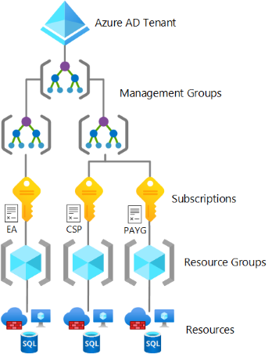

This critical design area focuses on the two highest levels of alignment across all of your Azure deployments; your Azure billing offer and the association of that offer with an Azure Active Directory (Azure AD) tenant.
Azure billing &
AAD Tenant

Slide 26
Billing & AAD Design Area Considerations and Recommendations
Ask basic security questions during the Azure AD design phase, such as how the customer manages credentials and how they controls human, application, and programmatic access.
An Azure subscription can only trust one and only one Azure AD tenant at a time.
If there’s no identity infrastructure, start by implementing an Azure AD only identity deployment. Don’t forget to define your Azure SSO strategy!
Add at least one custom domain and define a single-sign on strategy using AAD Connect.
Enforce MFA via CAP for all privileged accounts ASAP. No MFA = “pleasebreachme”
Don’t forget to create a break-glass account.
Use Azure Lighthouse to grant third parties and / or Microsoft partners access to Azure. But Azure Lighthouse only supports delegation at the subscription and resource group scopes.
Avoid creating multiple Azure AD tenants. Even if you are an ISV. Unless you have a rock-solid reason.

Slide 27

Identity & Access Management
This critical design area establishes a foundation for the management of identity and access.

Slide 28

Azure AD and Azure Roles
(Don’t confuse the two of them)
AAD Roles
Azure IAM Roles
Manage access to Azure AD resources
Can be scoped to Tenant, Administrative Unit, or Object (application)
Accessible in the Azure Portal and M365 Admin Portal
AAD Global Admin can self-assign permissions to manage Azure resources
Manage access to Azure resources
Can be scoped to Management Group, Subscription, Resource Group, or Resource
Accessible in the Azure Portal

Slide 29
Identity and Access Management Design Area
Considerations and Recommendations
Consider centralized and delegated responsibilities to manage resources deployed inside the landing zone.
Which services or applications within your landing zone support Azure Active Directory authentication?
Does the organization need to extend a current on-premises Active Directory domain into Azure?
Are there applications that are partly hosted on-premises and partly hosted in Azure?
Use AAD-only groups to assign access to Azure resources & start with built-in Azure role definitions
Add on-premises groups to AAD-only groups where applicable
Deploy MFA + CAP for users with access to Azure & use PIM to establish zero standing access
Use custom roles where more granular access is required
Use managed identities instead of service principals for authentication to Azure services

Slide 30

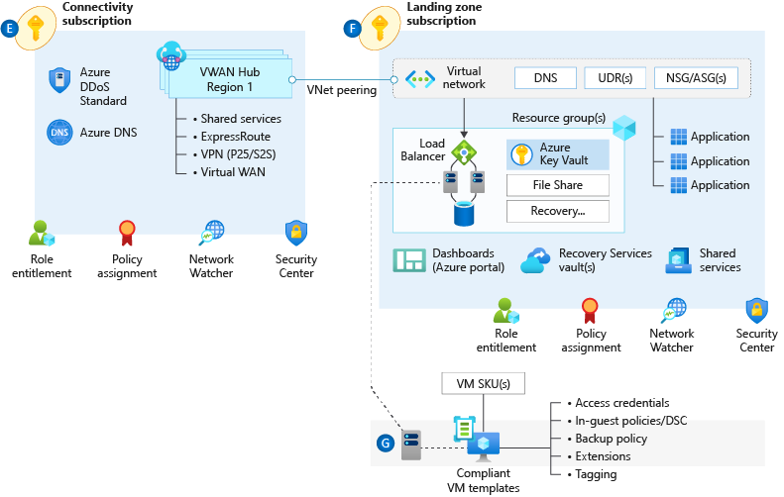
Network Topology & Connectivity
The network topology and connectivity design area is critical for establishing a foundation for your cloud network design.

Slide 31
Network Topology & Connectivity Design Area Considerations & Recommendations
Define a topology. There’s only 2 – Hub & Spoke (default option for nearly all cases in GR) and Virtual WAN.
Plan IP Addressing. Don’t use /16 unless really needed. Use at least /23 for Hub. Avoid overlapping IP address, including BCDR scenarios. Azure reserves 5 IP addresses from every subnet. Some Azure services require dedicated subnets. These dedicated subnets might have restrictions around naming, sizing, NSGs, and UDRs.
When you use multiple ExpressRoute circuits, optimize ExpressRoute routing via BGP local preference and AS PATH prepending. Deploy a zone-redundant ExpressRoute gateway in the supported Azure regions.
Monitor your network. Use ExpressRoute Insights, Network Watcher, and Connection Monitor.
Use virtual network injection for supported Azure services to make them available from within your virtual network.
Azure PaaS services that have been injected into a virtual network still perform management plane operations by using public IP addresses. Ensure that this communication is locked down within the virtual network by using UDRs and NSGs.

Slide 32
Network Topology & Connectivity Design Area Considerations & Recommendations
Use Private Link, where available, for shared Azure PaaS services. Private Link is generally available for several services and is in public preview for other services.
Use virtual network service endpoints to secure access to Azure PaaS services from within your virtual network, but only when Private Link isn't available and there are no data exfiltration concerns. Don't use virtual network service endpoints when there are data exfiltration concerns, unless you use NVA filtering.
Perform application delivery within landing zones for both internal-facing and external-facing applications. For secure delivery of HTTP/S applications, use Application Gateway v2 and ensure that WAF protection and policies are enabled in prevention and not detection mode. Use a partner NVA if you can't use Application Gateway v2 for the security of HTTP/S applications.
When you're using Front Door and Application Gateway to help protect HTTP/S applications, use WAF policies in Front Door. Lock down Application Gateway to receive traffic only from Front Door.
Plan for inbound and outbound internet connectivity. Use Azure Firewall to govern outbound internet traffic, east <-> west, and on-premises <-> Azure traffic.

Slide 33

Resource Organization
The critical resource organization design area establishes consistent patterns for organizing resources deployed to the cloud.

Slide 34
Resource Organization Design Area Considerations and Recommendations
Avoid replicating the organization’s hierarchy chart. What if the customer goes thru a re-org?
Avoid organizing for billing purposes. The industry standard is to use Tags (accounting) + Azure Cost Management to query & aggregate costs. Make this available to application owners.
Keep the management group hierarchy flat (3-4 levels)
Focus on organizing based upon Azure Policy Assignments (e.g., restrict public IP on internal workloads, prod/non-prod naming conventions, etc.)
Utilize a sandbox management group & configure a default management group for new subscriptions
Limit Policy assignments made at the root management group
Create management groups to represent regulatory workloads (GDPR, PCI, region-locked, etc.)
Consider limits and quotas within the Azure platform for each service that your workloads require.
Raise support requests for quota increases under subscription provisioning, such as for total available VM cores within a subscription. Ensure that quota limits are set before workloads exceed the default limits.
Use reserved instances to manage capacity in some regions. Workload can then have the required capacity for high demand resources in a specific region.

Slide 35
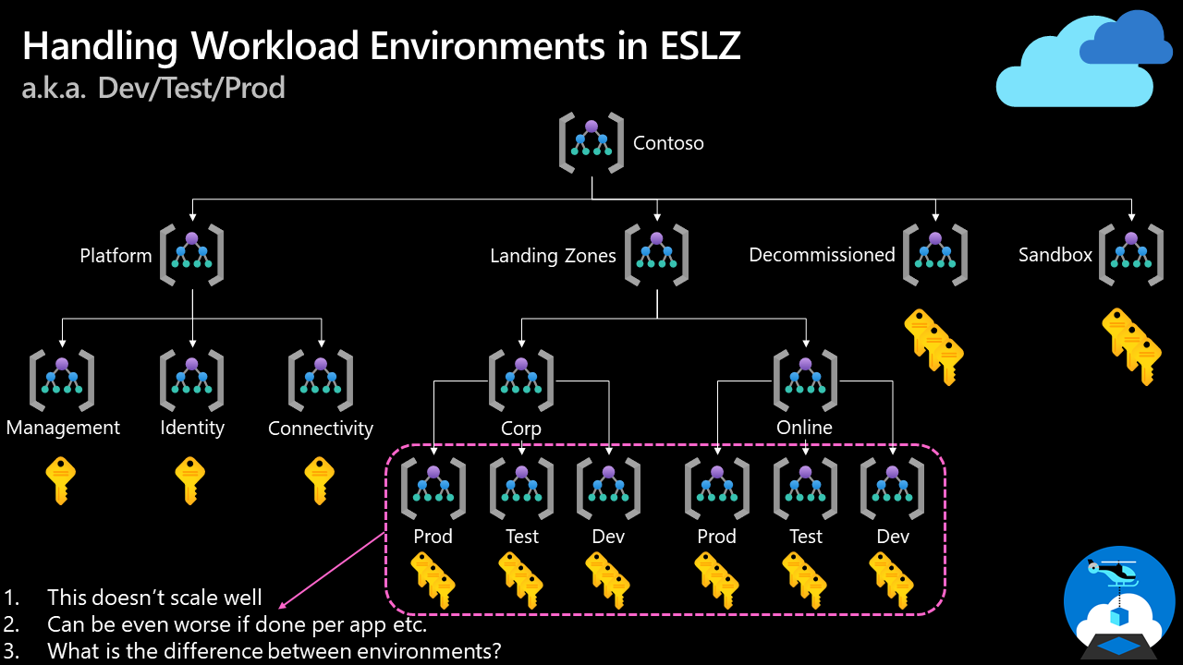
How do we handle "dev/test/production" workload landing zones in enterprise-scale architecture?

Slide 36
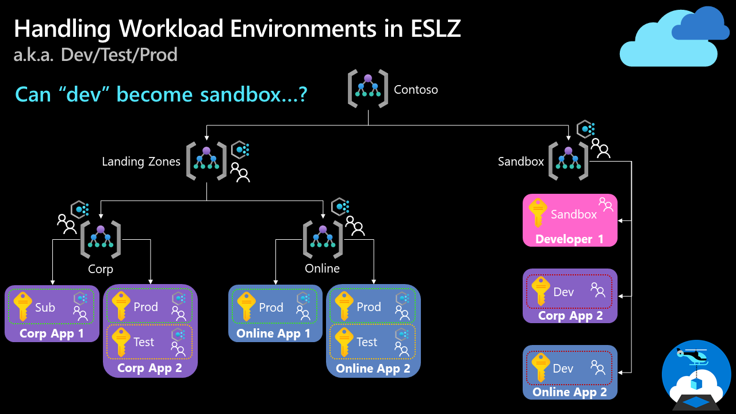
How do we handle "dev/test/production" workload landing zones in enterprise-scale architecture?
Note: We discussed this topic in our enterprise-scale community call in August 2021. You can find the recording on YouTube.

Slide 37

Security
This design area creates a foundation for security across your Azure, hybrid, and multicloud environments.
You can enhance this foundation later with security guidance outlined in the Cloud Adoption Framework's Secure methodology.

Slide 38
Security Design Area Considerations and Recommendations
Which teams require notifications for security alerts?
What about emergency patching for critical vulnerabilities?
Who requires access to encryption keys in the environment? And who will be responsible for managing the keys?
Develop and follow a roadmap to secure privileged access against cyber attackers.
Use AAD PIM, identify & categorize accounts in highly privileged roles, define at least two break-glass accounts, enforce MFA with CAP.
Enable Defender for Cloud to protect your environment and your workloads.
Use Security Posture to monitor your overall security posture. Use the Secure Score Over Time workbook.
Apply Zero-Trust and Defense-in-Depth principles. Apply and enforce network segmentation.
Use Azure Policies to audit and enforce governance around security, compliance and regulatory requirements.

Slide 39
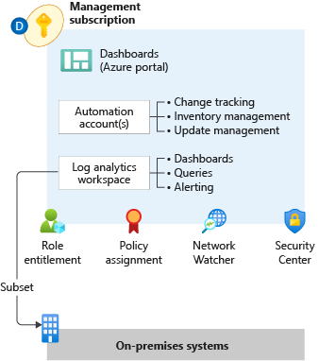

Management
This design area establishes a foundation for operations management across your Azure, hybrid, or multicloud environments.

Slide 40
Management Design Area
Considerations and Recommendations
Observability not Monitoring. Seek total visibility, a key monitoring principle, as soon as possible. Once initial observability is achieved, then build upon that initial level of visibility to develop actionable alerts (don’t spam!), create useful dashboards, and evaluate AIOps solutions.
The ALZ Accelerator includes diagnostic settings for activity logs, VMs, and PaaS resources sent to Log Analytics. Data sent to a different region via Diagnostic settings doesn't incur data transfer charges.
Use a single monitor logs workspace to manage platforms centrally except where Azure RBAC, data sovereignty requirements, and data retention policies mandate separate workspaces.
Export logs to Azure Storage if log retention requirements exceed two years.
Don't send raw log entries back to on-premises monitoring systems. Instead, adopt a principle that data born in Azure stays in Azure.
Use Azure Monitor Metrics for time-sensitive analysis. Use Azure Monitor Logs for insights and reporting. Use Azure Monitor alerts for generating operational alerts.
Use Update Management in Azure Automation as a long-term patching mechanism

Slide 41
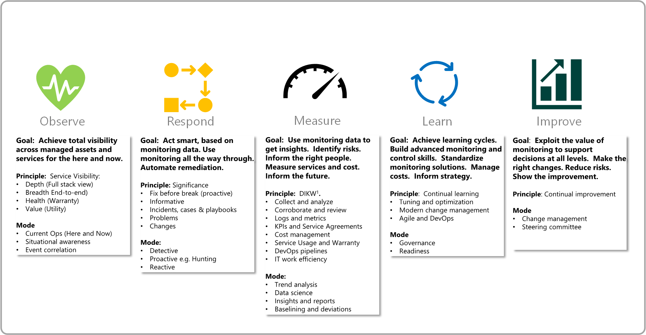
Management Design Area
The 5 Disciplines of Monitoring

Slide 42

Management Protect and Recover
Murphy’s law
"Anything that can go wrong will go wrong.“
Also, because sh!t happens.

Slide 43
Building reliable systems is a shared responsibility
Your application
Your app or workload architecture, built on the below.
Resiliency features
Optional Azure capabilities you enable as needed – high availability, disaster recovery, and backup.
Resilient foundation
Core Azure capabilities built into the platform – how the foundation is designed, operated, and monitored to ensure availability.

Slide 44
Resilience, HA, DR, and Reliability
Resilience
The ability to recover gracefully and continue functioning with minimal downtime
HA
The ability to stay available during outages
DR
The ability to continue operations when normal repair activities cannot recover in a reasonable timeframe
Reliability
Combined measure when an application or services is resilient, highly available, and has a defined approach to backup and DR

Slide 45
Resilience, HA, DR, and Reliability
RTO vs RPO
Recovery Point Objective (RPO)
Disaster Hits
Recovery Time Objective (RTO)
Time
Data Lost
Downtime

Slide 46
Resilience, HA, DR, and Reliability
Resilience vs Disaster Recovery
Resilience and Disaster Recovery (DR) are not the same
Customers may have different goals for ongoing resilience than infrequent disaster responses
Don’t assume one solution for both unless they have the same goal
DR frequently has geographic separation requirements which are difficult to deal with in live transactional systems due to imposed network latency
For both resilience and DR, it doesn’t exist if it isn’t tested
Fault injection is a good approach for all reliability measures
Assume DR must be tested on a live system.
Often regulatory requirements will mandate this so testability without incurring business impact should be a goal

Slide 47
Business Continuity and Disaster Recovery
Considerations and Recommendations
Review the Reliability Pillar from Well Architected. If it’s not measurable, it’s not actionable. Define the RTO and RPO requirements for each workload; if you can’t then assign a default.
Eval and plan application operations with reduced functionality or degraded performance during an outage.
Eval workload suitability for Availability Zones or availability sets. Not all Avail. Zones are equal – always measure latency.
What about consistent backups for apps and data?
Prevent an “Ooops!” moment. Use resource locks to prevent accidental deletion of critical shared services. Prevention is better than cure.
Employ ASR for Azure-to-Azure VM DR scenarios.
Use native PaaS DR capabilities and Azure-native backup capabilities.
Use multiple regions and peering locations for ExpressRoute connectivity.
Avoid using overlapping IP address ranges for production and DR sites.

Slide 48
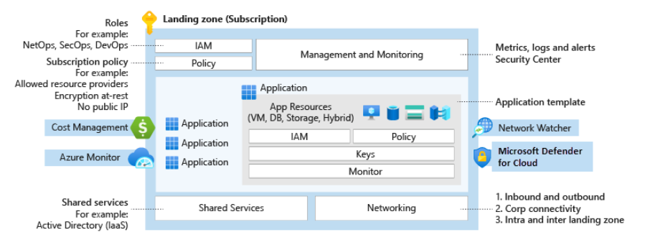
Governance
Azure governance establishes the tooling needed to support cloud governance, compliance auditing, and automated guardrails.
Governance provides mechanisms and processes for maintaining control over platforms, applications, and resources in Azure.

Slide 49
Governance
Going faster, whilst maintaining control and stability.
Change advisory review boards might hinder an organization’s innovation and business agility.
Azure Policy increases workload efficiency by replacing such reviews with automated guardrails and adherence audits.

Slide 50
Governance Design Area
Considerations
Determine what Azure policies are needed based on your business controls or compliance regulations. Use the policies included in the ALZ Accelerator as a stating point.
How is the organization’s cost and recharging model structured? What are the key data points required to accurately see cloud services spend? Finding the structure of tags that fits your cost and recharging model might help the customer track cloud spend.
Azure Cost Management + Billing might help support ongoing governance cost and spending in Azure, or other multicloud environments.
What are the groups of resources in the environment? These groups can share configuration characteristics that might be required to help stay consistent.
What tools and guardrails need to be enforced across the environment as part of a security baseline? And who might be notified when deviations are found?
Who might have access to audit logs for identity and access management? Who might be notified when suspicious sign-in events occur? Consider using AAD reports to govern activity.

Slide 51
Governance Design Area
Recommendations
Identify required Azure tags and use the append policy mode to enforce usage. Use the tagging strategy article as a starting point
Map regulatory and compliance requirements to Azure Policy definitions and Azure role assignments. Establish Azure Policy definitions at the top-level root management group as they might be assigned at inherited scopes.
Use built-in policies to minimize operational overhead.
Manage policy assignments at the highest appropriate level with exclusions at bottom levels, if necessary but limit the number of Azure Policy assignments made at the root management group scope to avoid managing through exclusions at inherited scopes.
Use Azure Cost Management + Billing to implement financial oversight on resources in your environment. Use tags in Azure to append metadata to resources, which might enable granular analysis of spend (such as cost center, environment, project, owner, etc.).

Slide 52
Platform Automation & DevOps
Platform automation and DevOps evaluate opportunities to modernize your approach to environmental deployment with infrastructure as code options.

Slide 53
Platform Automation and DevOps Design Area
Considerations and Recommendations
Concerning central teams, consider using pipelines for continuous integration and continuous deployment.
Pipelines might be used to manage policy and role definitions, policy assignments, management group hierarchies, and subscriptions. These pipelines help ensure that you can operationally manage multiple subscriptions and conform to a desired state.
The blanket application of a DevOps model won't instantly establish capable DevOps teams.
The Azure landing zone accelerator can help integrate continuous integration and continuous deployment (CI/CD) pipelines into the environment using GitHub with GitHub Actions. The portal process guides you through the steps to set up the integration.
By integrating CI/CD pipelines into the environment, platform resources can be managed as code in a repository.

Slide 54
Enterprise-scale Implementation Guide

Slide 55


Enterprise-scale Implementation Guide How to get started
To establish an initial configuration
Must be performed by the Azure and AAD admins
Primarily one-off activities
Sequential by nature
What-must-be-true
To instantiate a “landing zone“
Require user input to kickstart the workflow which will coordinate resource creation within AAD and AD
Recurring activities
To operationalize at scale, these activities must follow the principal of "Infrastructure-as-Code" and automate using deployment pipelines.
File → New → Region &
File → New → Landing Zone

Slide 56
Enterprise-scale Implementation Guide How to get started
Activities & Policies
AAD Tenants
Management Group & Subscription
Global Networking & Connectivity
Security, Governance & Compliance
Platform Management & Monitoring
What-must-be-true
Activities & Policies
Create new Subscriptions and Regions
Connect and secure all VNets
Protect Vnets across VHubs
Assign owners and Management Groups
Setup budgets, alerts, and security contacts
Create AAD groups
Provision required services
Assign policies
File → New → Region &
File → New → Landing Zone

Slide 57
Enterprise-scale Reference Implementation

Slide 58
The enterprise-scale architecture is modular by design and allow customers to start with foundational landing zones that support their application portfolios, regardless of whether the applications are being migrated or are newly developed and deployed to Azure. The architecture can scale alongside the customer's business requirements regardless of scale point.

Slide 59
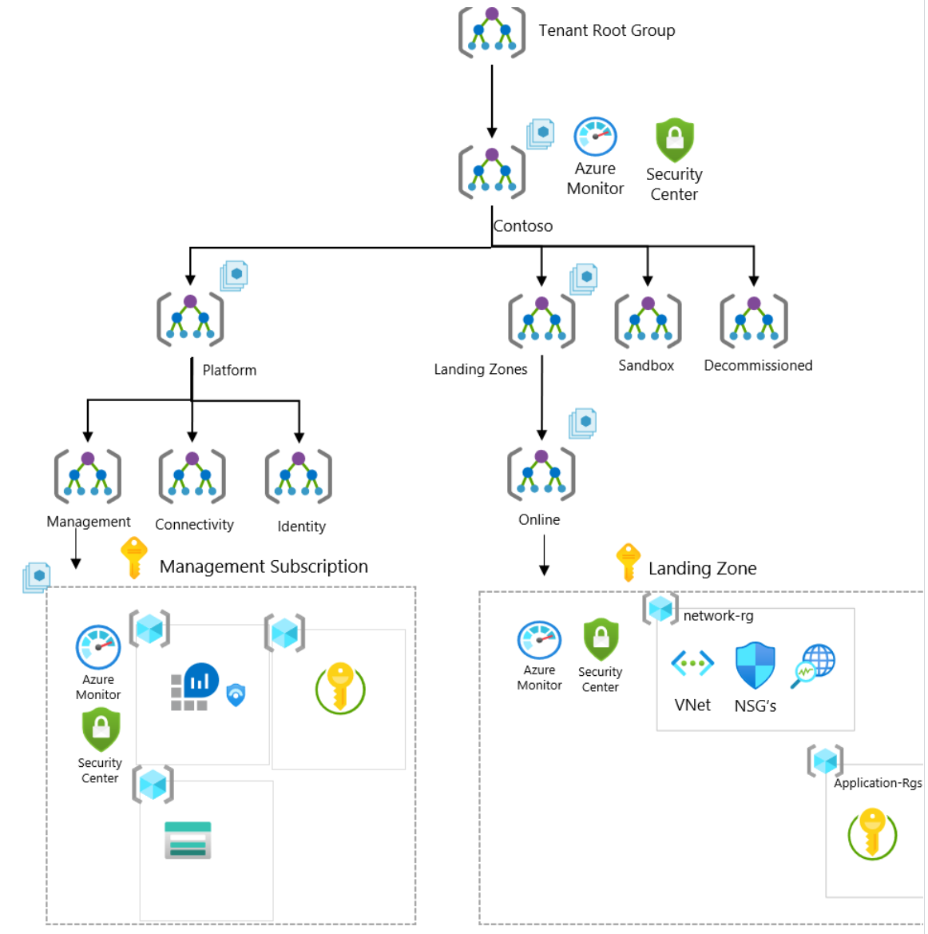
Enterprise-Scale foundation
If the business requirements changes over time, such as migration of on-prem applications to Azure that requires hybrid connectivity, the architecture allows you to expand and implement networking without any refactoring of the architecture nor implications to the runtime state of existing applications. You will simply create the connectivity subscription and place it into the platform management group and assign Azure Policy for the networking topology you desire.

Slide 60
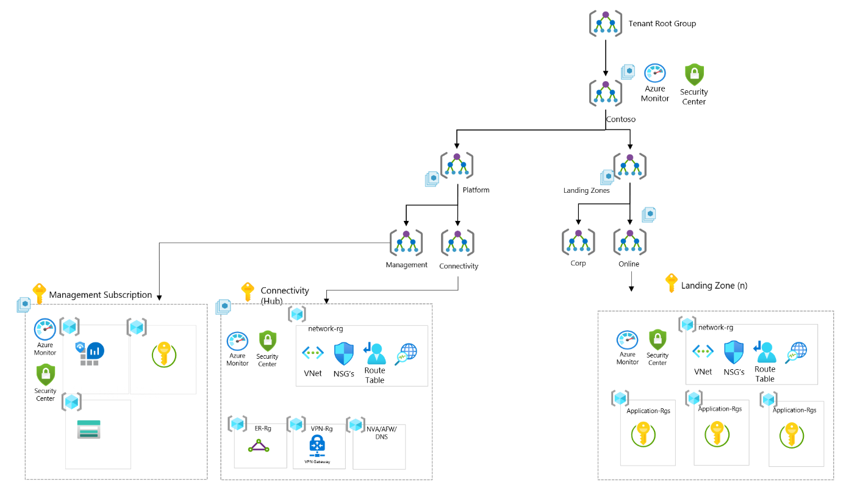
Enterprise-Scale foundation
Enterprise-Scale foundation + Connectivity
If customer started with a Enterprise scale foundation deployment, and if the business requirements changes over time, such as migration of on-prem applications to Azure that requires hybrid connectivity, you will simply create the connectivity subscription and place it into the platform management group and assign Azure Policy for the hub and spoke network topology.

Slide 61
Demo

Slide 62
Resources & Next Steps

Slide 63
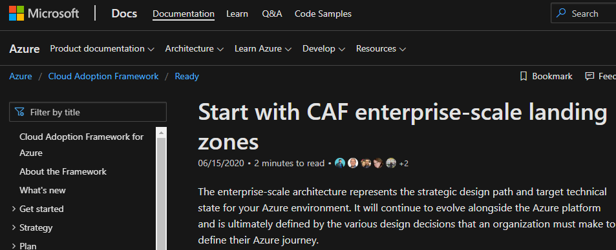
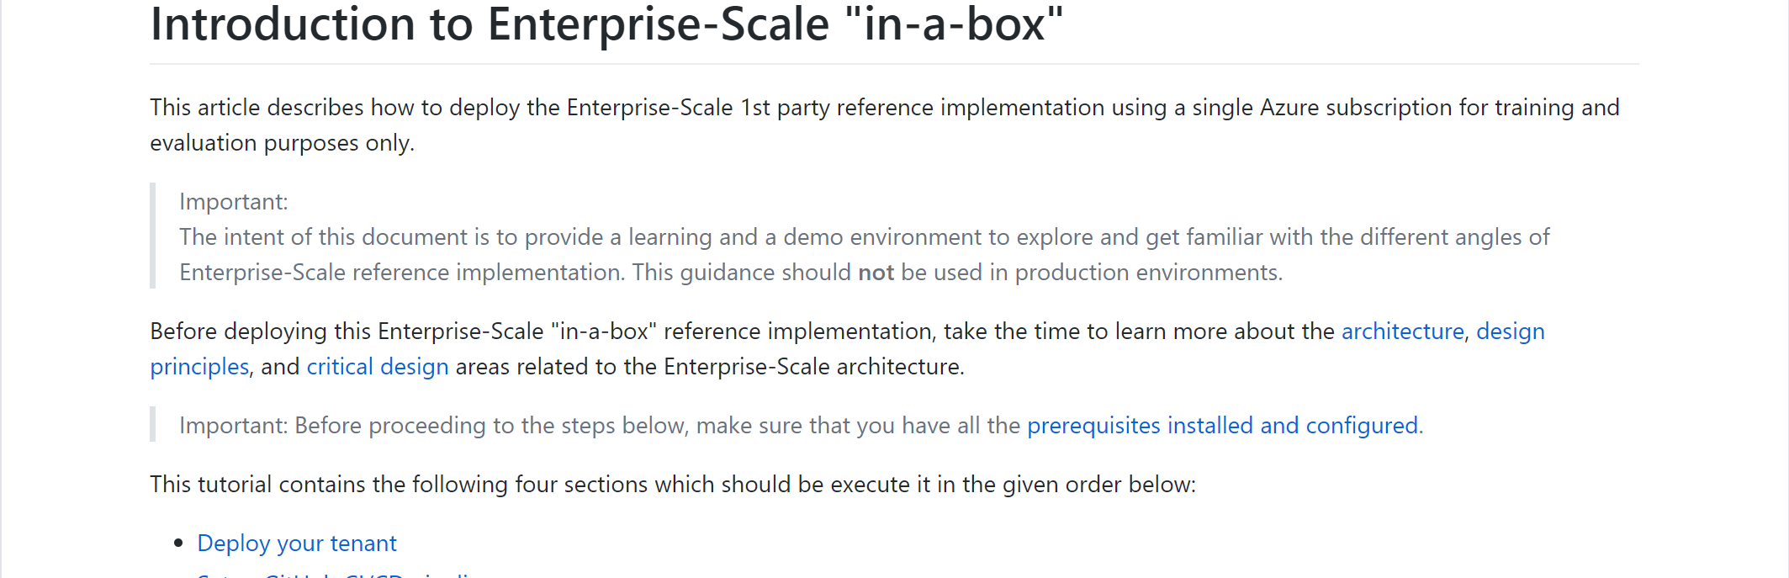
Enterprise-Scale Resources
Solution Complete 👍
Opinionated Architecture & Design Guidelines - Complete
Reference Implementation - Complete
Engineering Signoff - Complete
Enterprise-scale landing zones Architecture guidance and reference implementation:
Introduction to Enterprise-Scale “in-a-box” hands on activity
Ready overview: http://aka.ms/adopt/ready
Download a Visio file that contains Enterprise-scale architecture diagram.

Slide 64
Next steps
Get ready to deploy guidance on Cloud Adoption Framework
Learn more about the Design Principles for Enterprise-scale
Drill down into the Enterprise-scale Design Guidelines to build your environment
Configure your environment using the reference implementation guide
Leverage the Enterprise-scale landing zones template schema
Let’s get started and build your enterprise-scale landing zone for successful deployment and use of Azure

Slide 65
Thank you!

